Slide 1

Model-Based
Reinforcement Learning
Applied RL course
Assaf Hallak · NVIDIA
Notes:
Cover illustration generated for this lecture deck.

Slide 2
02
Policy Gradients
PG methods learn a direct mapping from state to action
Assume (almost) nothing about the environment
No Markov assumption
No full observability assumption
PG methods use the same computation regardless of difficulty
They are the ultimate hammer, but at what cost?
Requires massive amounts of data
Often stochastic and noisy
Limited by policy network expressivity
Hard to verify and debug
sₜ
πθ
aₜ
direct mapping
MODEL-BASED RL
2

Slide 3
03
Thought experiment: chess
Playing chess with PG means waiting to lose at the end of the game, only then learning that something was suboptimal along the way
How do humans play chess?
We learn the rules
We plan several moves ahead, considering the opponent’s possible moves
We know how to estimate positions along the way
MODEL-BASED RL
3

Slide 4

04
Inductive bias
Assumptions about the structure of the world
More assumptions:
Higher data efficiency
Better generalization under these assumptions
Better performance
Wrong assumptions lead to systematic bias
A useful assumption helps as long as it matches the world.
MODEL-BASED RL
4

Slide 5
05
RL approaches
RL has 3 archetypes of inductive bias levels:
Policy search - assumes almost nothing (REINFORCE, TRPO)
Learning the solution directly
Value-based - assumes full observability (Q-learning, DQN)
Learning - optimizing iterative process
Enables convergence to a single point
Model-based - assumes the Markov property (MCTS, MuZero)
Enables simulation and planning
In simple environments - analytical solution
Learning once, then optimize
POLICY
VALUE
MODEL
more inductive bias
*Actor-critic methods are hybrid policy-value approaches (SAC, PPO)
MODEL-BASED RL
5

Slide 6
06
What is a model?
A model predicts the consequence of an action
CURRENT STATE
sₜ
NEXT STATE
sₜ₊₁
→
→
WORLD
MODEL
ACTION
aₜ
p̂(sₜ₊₁, rₜ | sₜ, aₜ)
REWARD
rₜ
→
→
KNOWN MODEL
Rules, simulator, physics
LEARNED MODEL
Fit predictive structure from data
MODEL-BASED RL
6

Slide 7
07
What is planning?
Planning is simulating future trajectories and choosing the action that is likely to result in the best outcome
Simulating requires a model
Best outcome requires evaluating a state with a value or Q-function
The knobs:
More trajectories: more possible futures. We usually focus on the more likely or beneficial ones. This also reduces the effect of bad modeling.
Lookahead: reduces the effect of a bad value estimate by shifting toward actual rewards
sₜ
simulate futures
MODEL-BASED RL
7

Slide 8
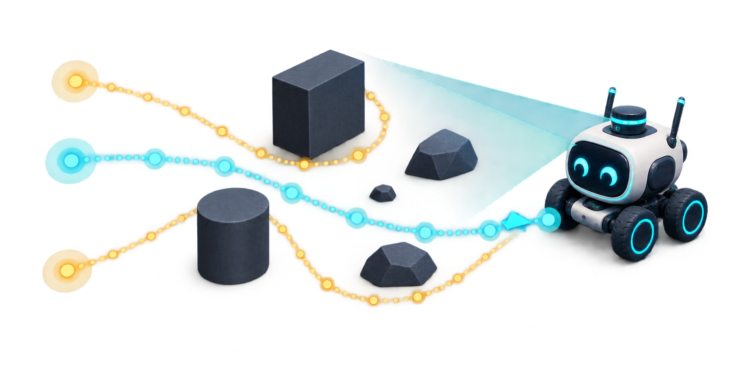
08
Model predictive control
Plan, act once, observe, then plan again
1 OBSERVE
→
2 IMAGINE
→
3 SCORE
→
4 ACT ONCE
current state
candidate action sequences
predicted returns
execute only the first action
← NEW OBSERVATION CLOSES THE LOOP
MPC continuously corrects the plan as the real world reveals new information.
MODEL-BASED RL
8
Notes:
MPC is also called receding-horizon control. At each decision step, optimize an action sequence under the model, execute the first action, observe the result, and solve again.

Slide 9
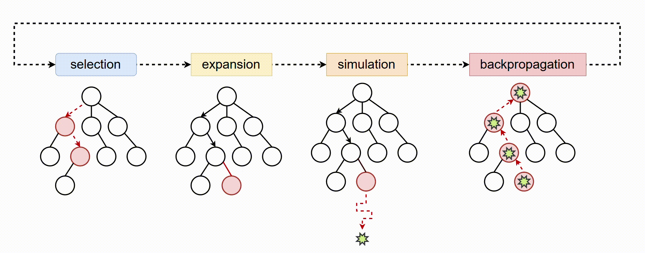
09
Monte Carlo Tree Search
Repeat:
Select the most promising state
Expand
Simulate
Backpropagate value
MODEL-BASED RL
9

Slide 10
10
MCTS properties
Focuses computation on promising trajectories using value estimates and an exploration bonus
Classical MCTS may evaluate a leaf with a rollout. Neural MCTS often uses a learned value function
More simulations expand the tree and improve value estimates
More compute usually produces better decisions
MODEL-BASED RL
10

Slide 11
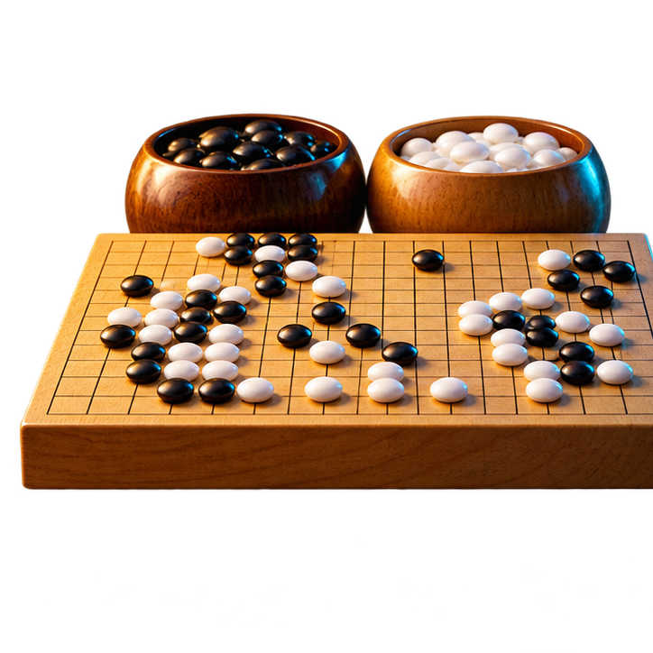
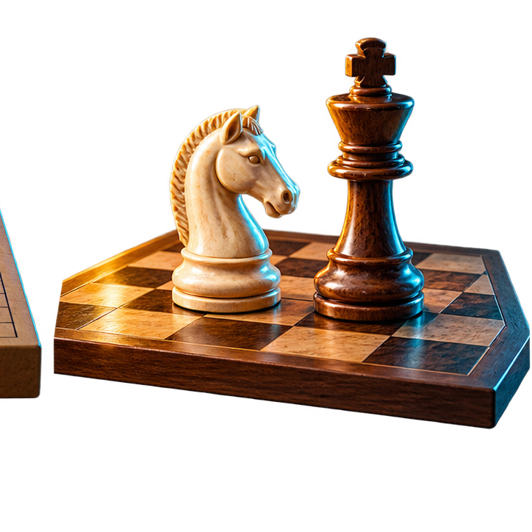
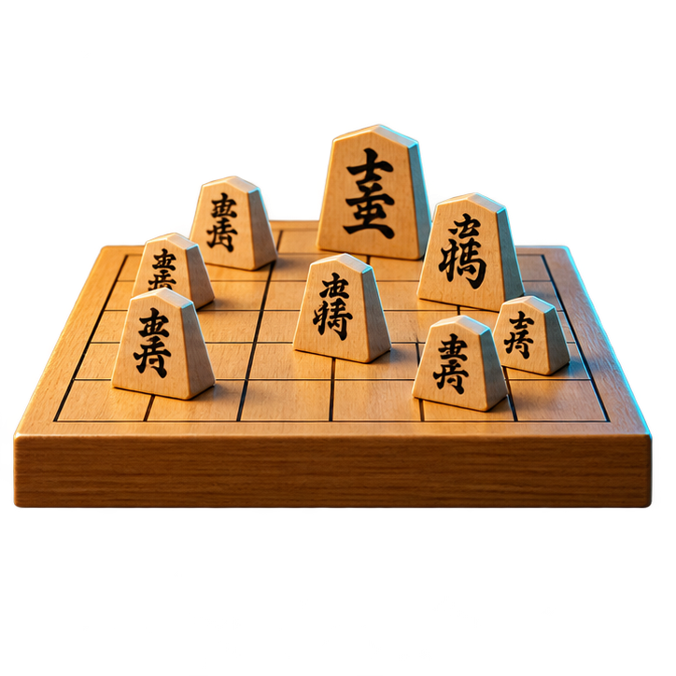
Known game rules = the model
11
AlphaZero
Keep MCTS, but:
A value network replaces random rollouts
A policy network supplies action priors; PUCT balances priors, value, and exploration
Improve through self-play
At each state:
Run hundreds of MCTS simulations
Record each action’s visit count N(s,a)
Choose an action from π(a|s) ∝ N(s,a)¹/ᵀ and continue until the game ends
Train the policy on MCTS visit counts and the value on the final game outcome
GO
CHESS
SHOGI
MODEL-BASED RL
11
Notes:
Source: Silver et al., Mastering Chess and Shogi by Self-Play with a General Reinforcement Learning Algorithm, 2017. AlphaZero uses known game rules for state transitions. PUCT combines policy priors, action values, and an exploration term.

Slide 12
12
MuZero
AlphaZero needs a simulator. MuZero instead learns the three mappings that planning needs.
REPRESENTATION hθ
DYNAMICS gθ
PREDICTION fθ
observation history → latent state
latent state + action →
next latent state + reward
latent state → policy + value
MCTS runs inside the learned latent dynamics model
LATENT, NOT PIXEL-PERFECT
The learned state only needs to preserve reward, policy, and value information. Like JEPA, prediction happens in representation space—but MuZero’s targets are planning-specific.
MODEL-BASED RL
12
Notes:
Sources: Schrittwieser et al., Mastering Atari, Go, chess and shogi by planning with a learned model, Nature 2020, https://www.nature.com/articles/s41586-020-03051-4. Assran et al., Self-Supervised Learning from Images with a Joint-Embedding Predictive Architecture, CVPR 2023, https://arxiv.org/abs/2301.08243. The JEPA connection is conceptual: both predict in latent representation space, but MuZero is trained for planning targets and is not itself a JEPA.

Slide 13
13
Dreamer
Learn behavior from imagined latent trajectories
train the model
LATENT WORLD
MODEL
IMAGINED
TRAJECTORIES
REAL EXPERIENCE
train behavior
collect more experience
ACTOR + CRITIC
Benefit: high sample efficiency and cheap parallel imagination
Risk: model error biases the learned policy
DAYDREAMER — REAL ROBOTS
A quadruped learned to stand and walk from scratch in about 1 hour, without a simulator.
MODEL-BASED RL
13
Notes:
Sources: Hafner et al., Dream to Control: Learning Behaviors by Latent Imagination, 2019, https://arxiv.org/abs/1912.01603. Wu et al., DayDreamer: World Models for Physical Robot Learning, CoRL 2022, https://arxiv.org/abs/2206.14176. DayDreamer applied Dreamer to four physical robots; the quadruped learned to roll over, stand up, and walk from scratch in one hour without resets or a simulator.

Slide 14
14
Published applications
MBRL has strong published demonstrations across fields—but the evidence ranges from real hardware to simulation studies.
REAL ROBOTS
DRIVING SIMULATION
ROBOTICS — DayDreamer
AUTONOMOUS DRIVING — UA-MBRL
Learned online on four physical robots without simulators; a quadruped learned to stand and walk in about 1 hour.
An uncertainty-aware learned environment model generated virtual interactions for end-to-end vehicle control across driving scenarios.
Wu et al. · CoRL 2022
Wu, Huang & Lv · IEEE T-IV 2022
PK–PD SIMULATION
BUILDING SIMULATION
PRECISION DOSING — Propofol
ENERGY — CLUE HVAC CONTROL
A pharmacokinetic–pharmacodynamic model supplied synthetic experience for an RL dosing policy; the paper is explicitly a theoretical case study.
A Gaussian-process dynamics model and uncertainty-aware control were evaluated on a simulated five-zone office building.
Clinical and Translational Science · 2023
Ding et al. · ACM BuildSys 2023
MODEL-BASED RL
14
Notes:
Published examples and evidence status: (1) Wu et al., DayDreamer: World Models for Physical Robot Learning, CoRL 2022, https://proceedings.mlr.press/v205/wu23c.html — real-world training on four robots without simulators. (2) Jingda Wu, Zhiyu Huang, and Chen Lv, Uncertainty-Aware Model-Based Reinforcement Learning: Methodology and Application in Autonomous Driving, IEEE Transactions on Intelligent Vehicles, 2022, https://ieeexplore.ieee.org/document/9802913 — validated in autonomous-driving scenarios. (3) Model enhanced reinforcement learning to enable precision dosing: A theoretical case study with dosing of propofol, Clinical and Translational Science, 2023, https://pmc.ncbi.nlm.nih.gov/articles/PMC9662205/ — synthetic PK-PD study, not a clinical deployment. (4) Xianzhong Ding, Zhiyu An, Arya Rathee, and Wan Du, CLUE: Safe Model-Based RL HVAC Control Using Epistemic Uncertainty Estimation, ACM BuildSys 2023, https://doi.org/10.1145/3600100.3623742 — evaluated in EnergyPlus on a simulated five-zone office building.

Slide 15
15
Summary
MODEL-FREE
MODEL-BASED
Fewer structural assumptions
Often robust to model misspecification
Requires more real experience
No planning at decision time
Separates learning from optimization
Reuses experience through imagined futures
Enables planning and adaptation
Pays in model bias and planning compute
Model-based RL trades model bias and planning compute for sample efficiency and lookahead.
MODEL-BASED RL
15

